Slide 1

Examining the social and economic factors driving food insecurity in south African provinces

Slide 2
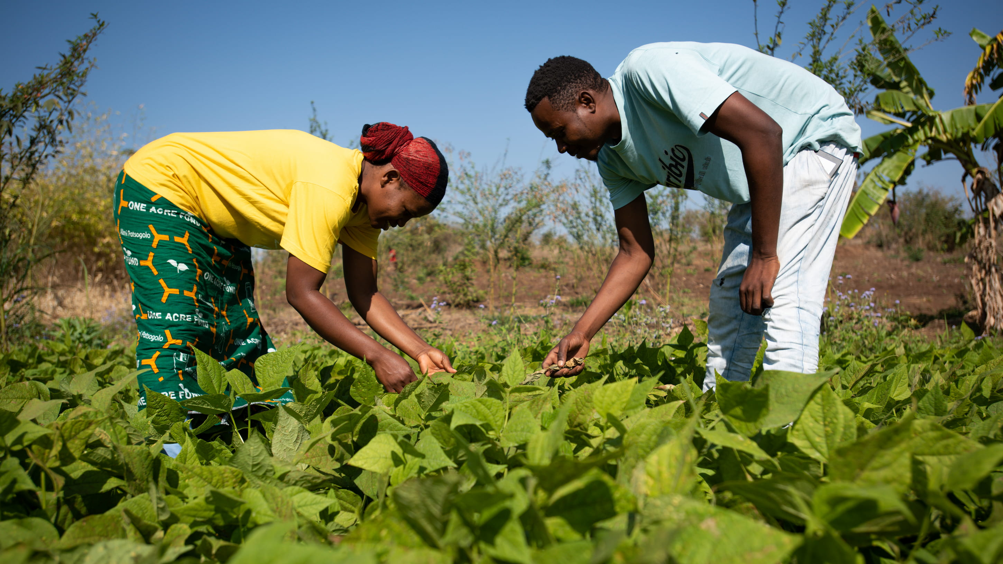
Introduction
What is Food insecurity?
What is Power BI ?
Sources: World Bank, WHO & FAO

Slide 3
Factors Contributing to Food Insecurity
Economic Indicators
Agricultural Productivity
Health Indicators
Social Policies and Programs

Slide 4

POWER BI FEATURES
Extraction (Power Query)
Transforming
Measures and Calculations
Visualization
Publishing

Slide 5
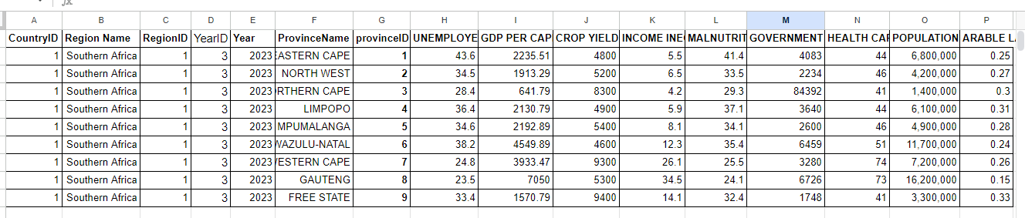
Food Insecurity in Different Provinces in SA - 2021-2023

Slide 6
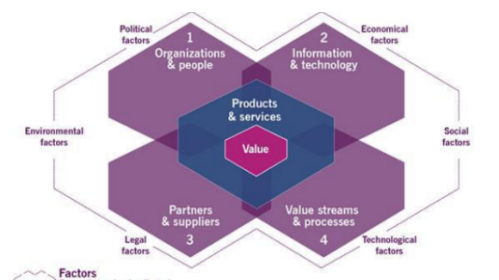
SERVICE VALUE STREAMS
This Photo by Unknown Author is licensed under CC BY

Slide 7
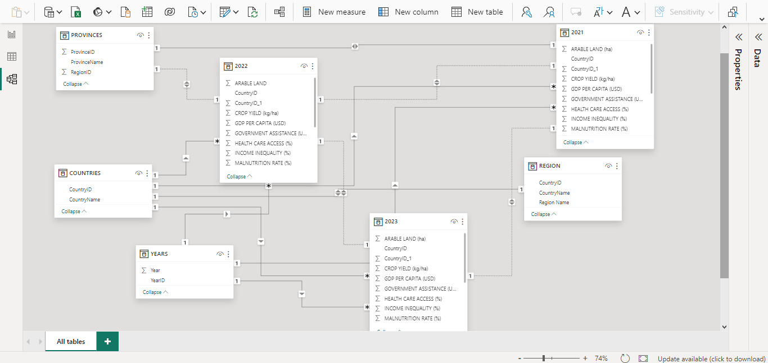
Entity Relationship Diagram

Slide 8
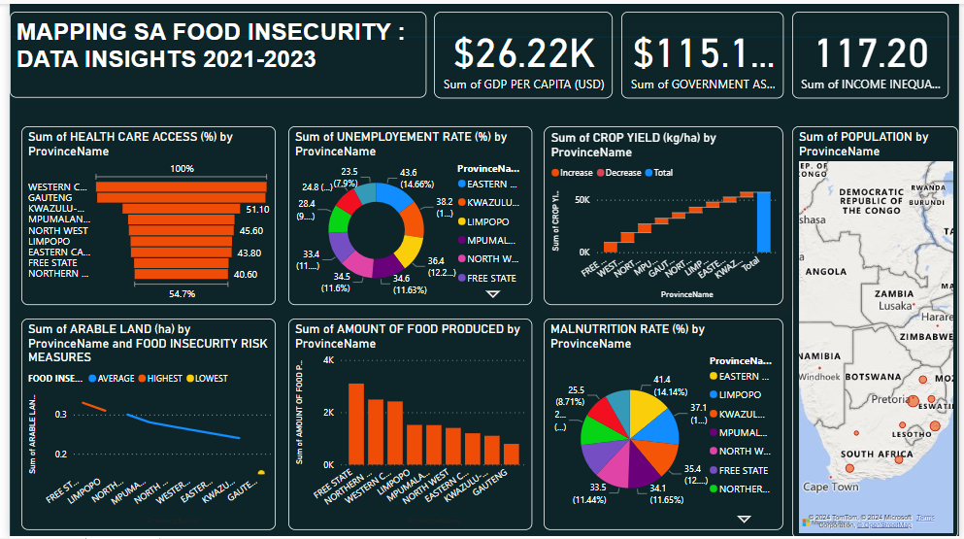
Data Analytics- Dashboard

Slide 9
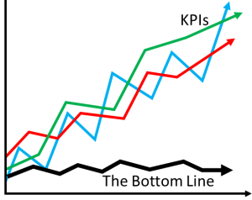
Key Performance Indicators
Food Insecurity Risk
Amount of Food Produced
This Photo by Unknown Author is licensed under CC BY-SA

Slide 10
Data Driven Strategies to Mitigate Food Insecurity
Agricultural Funds
Training/Educational Programs
Economic Support
Public Health Initiatives
Climate Smart Agriculture
Internet of Things (Net Zero)
Technology Utilization (Web Development)
Continual Improvement

Slide 11
CONCLUSION

